Slide 1


Implantable Bone Sensors for Monitoring Fracture Healing
Leonel Almanzar
Dr. David Margolis
University of Arizona: Orthopedic Surgery
AZ Space Grant Symposium 2024

Slide 2
Statement of Problem
Bones need weight to be healthy
Astronauts loose bone mass due to to microgravity
We need a method to monitor bone health in space
Implantable sensors we are currently using to measure fracture healing may be useful to monitor bone health in space

Slide 3
Objectives
Implant Osseo surface (bone surface) sensors onto fractured sheep femur
Measure and collect the strain and load the sheep place on their femur
Analyze the strain over time to see fracture healing

Slide 4
Methods
1. Set up the wireless telemetry system
2. Measure the strain data while walking on treadmill
3. Measure the strain and load as the sheep rocks
4. Use the strain and load data to find the stress

Slide 5
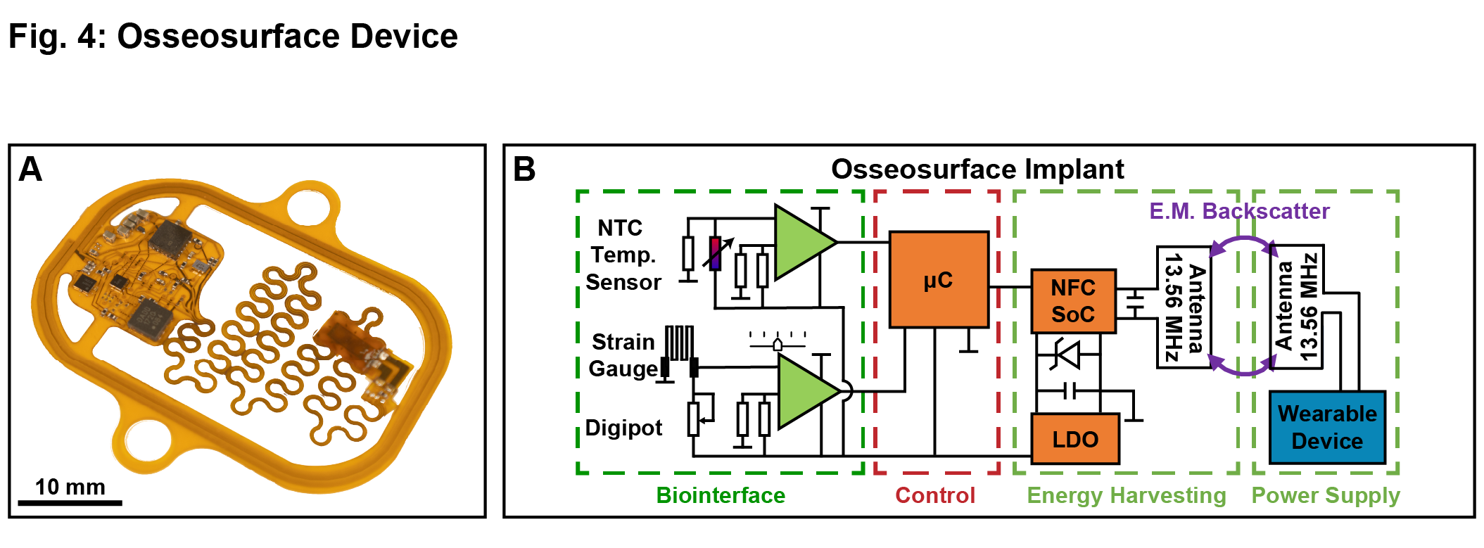
Wireless Telemetry Setup
Sensor is powered using magnetic resonance
Data is collected using near-field communication (NFC) with the antennas
Continuously scans for the data on the sensor
Figure 1: photograph of the Osseo surface sensor
Figure 2: Functional block diagram of sensor

Slide 6
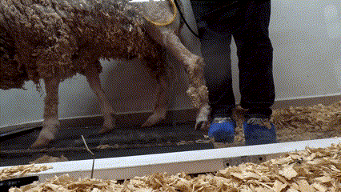
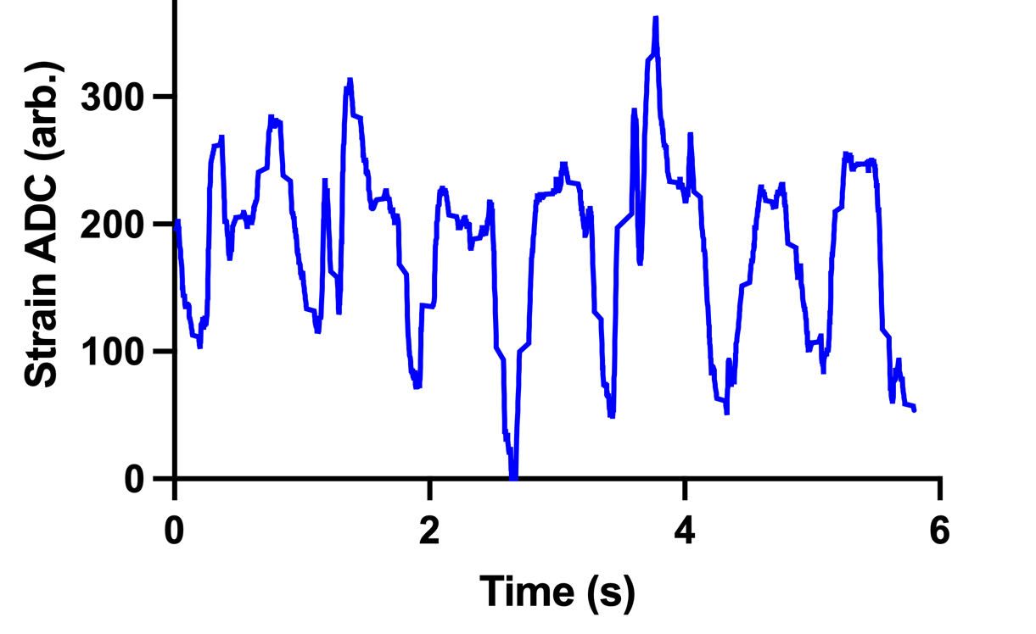
Walking
Sheep walks on treadmill for around 1-2 min
Measure the strain on the bone
Select correct data using video and graphs
Figure 3: Video of sheep walking on treadmill and
Figure 4: Strain vs time graph showing walking pattern

Slide 7
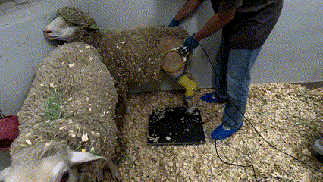
Rocking
Rock the sheep back and forth
Measure how much strain and load
Using time and video to accurately align the load and strain data
Figure 5: Video of sheep rocking while collecting load and strain

Slide 8
Results
Figure 6: Average Peak to Peak Strain between Week 5 and Week 12

Slide 9
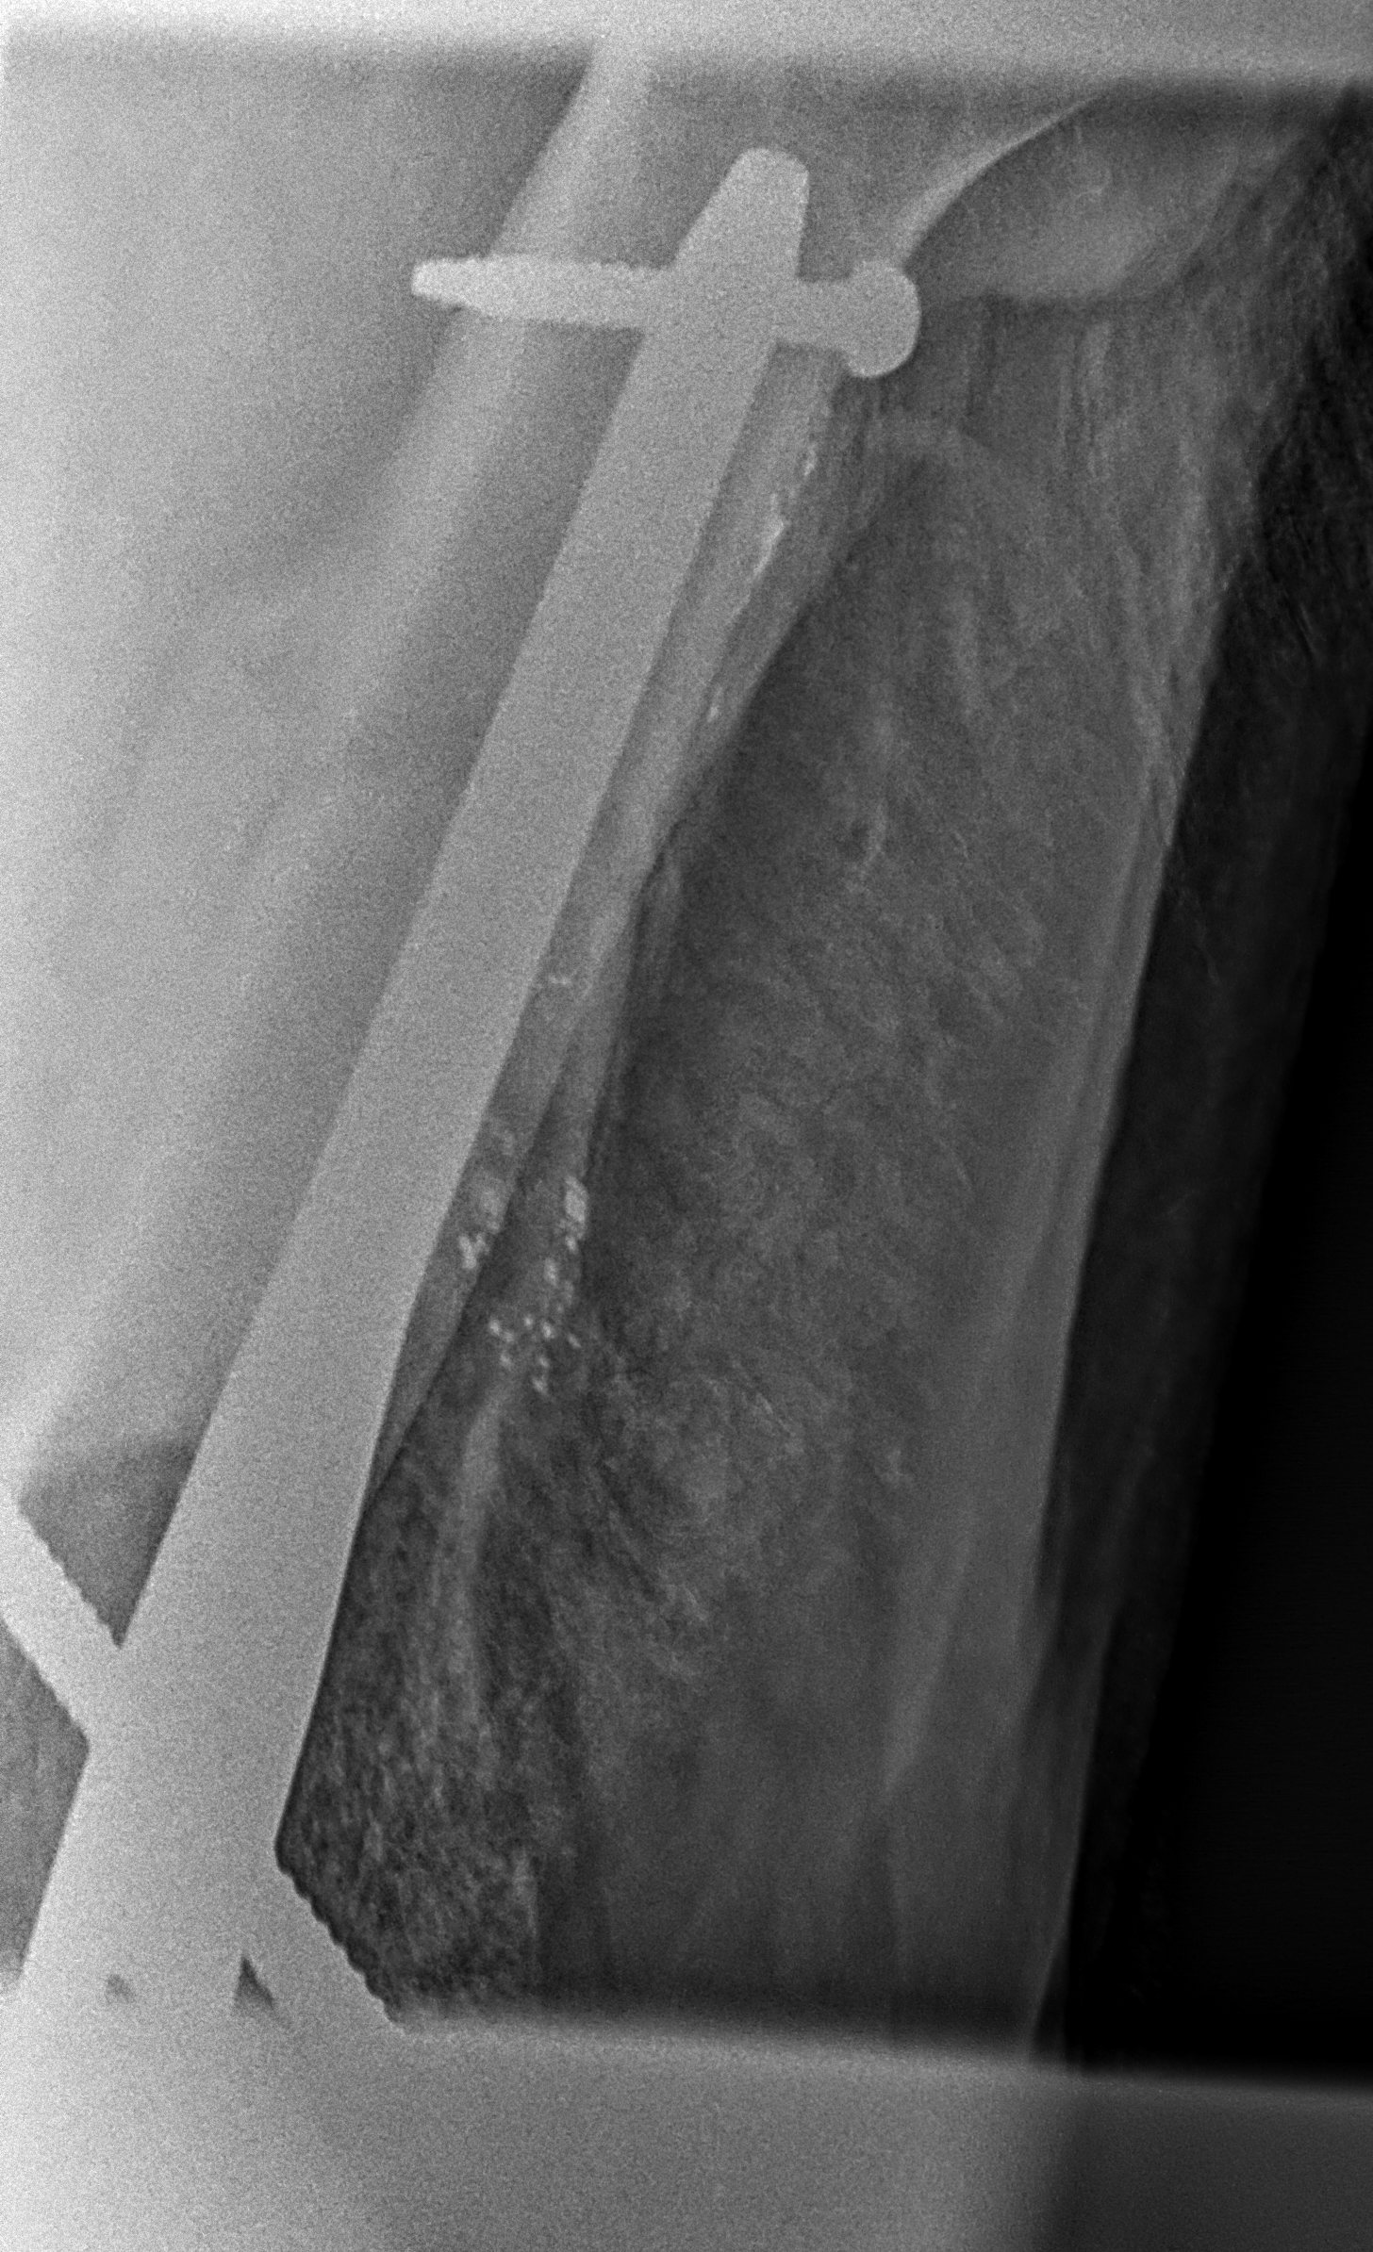
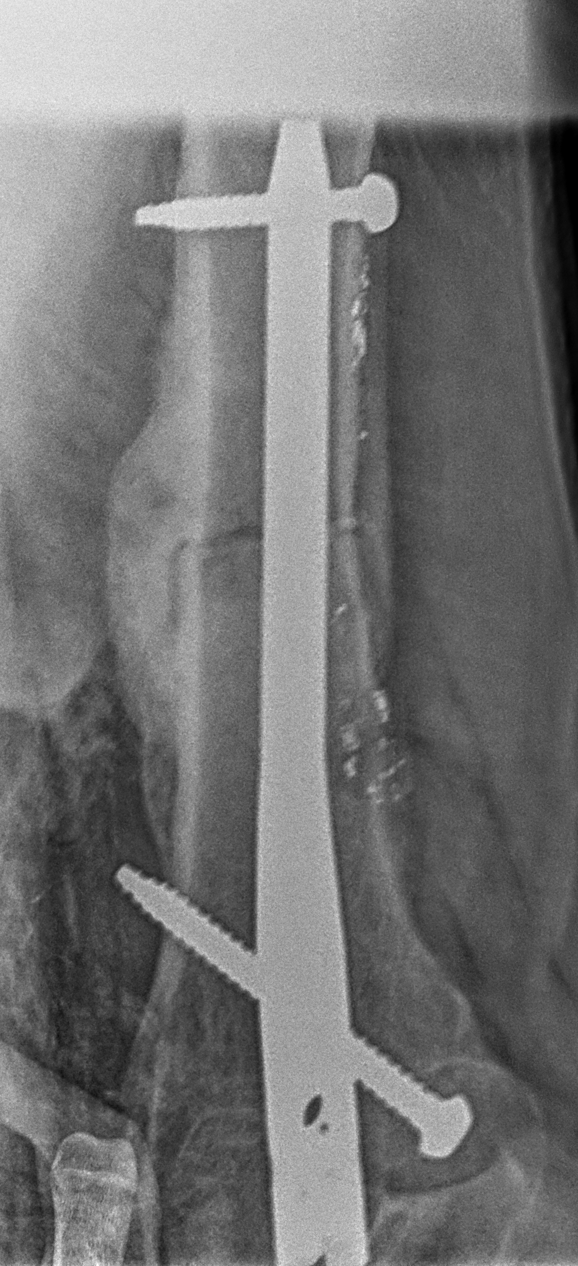
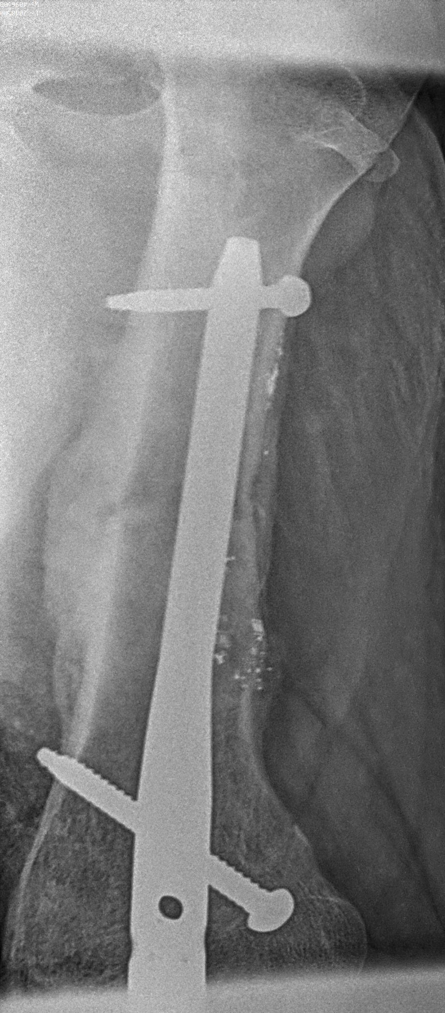
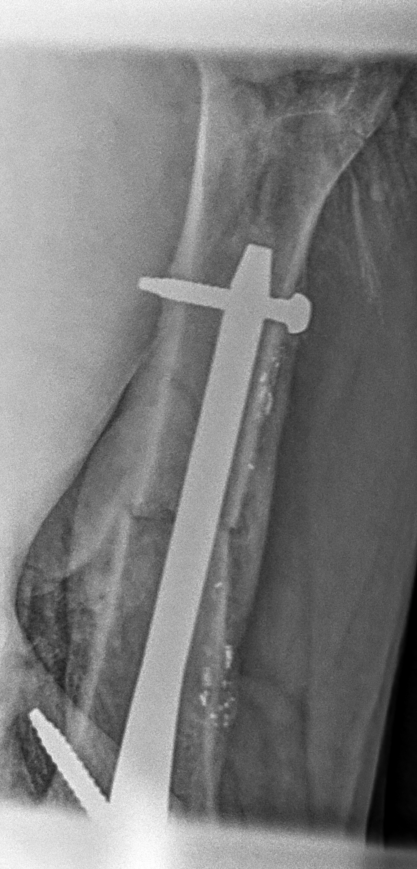
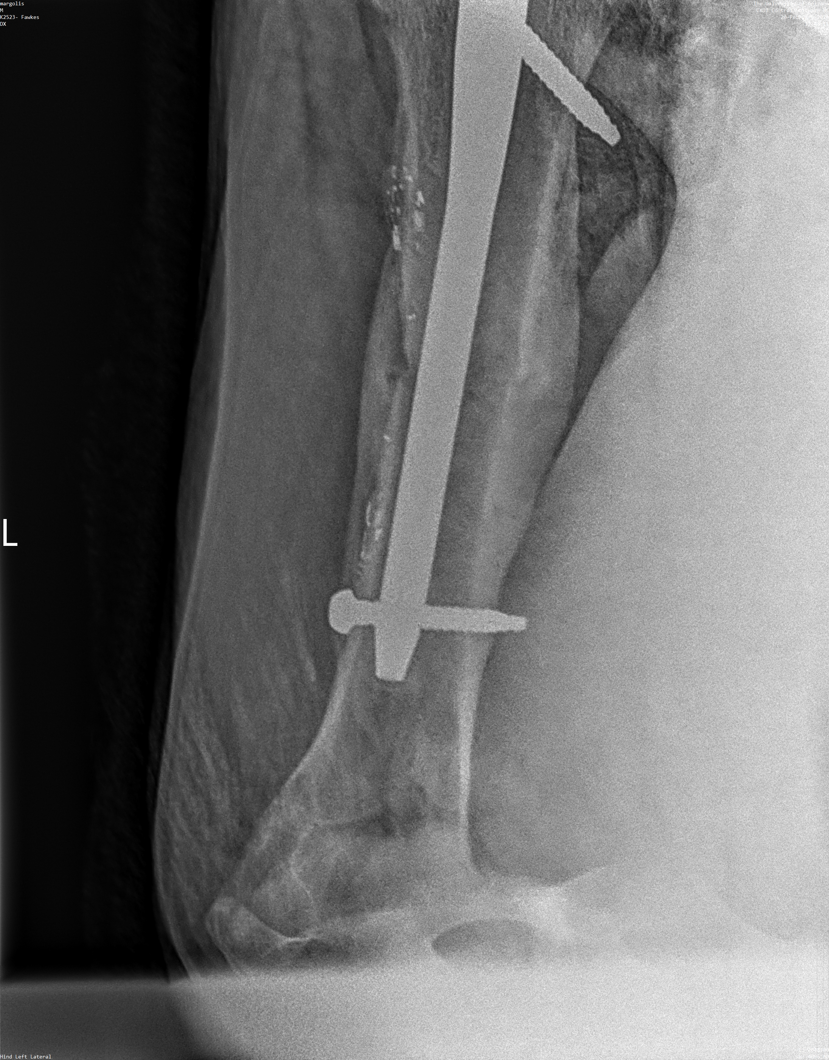
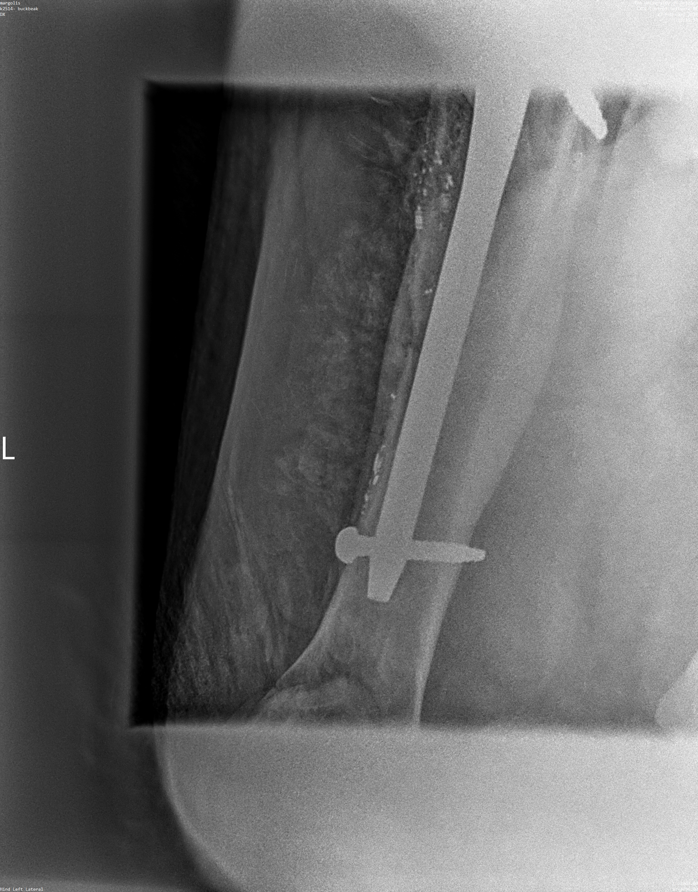
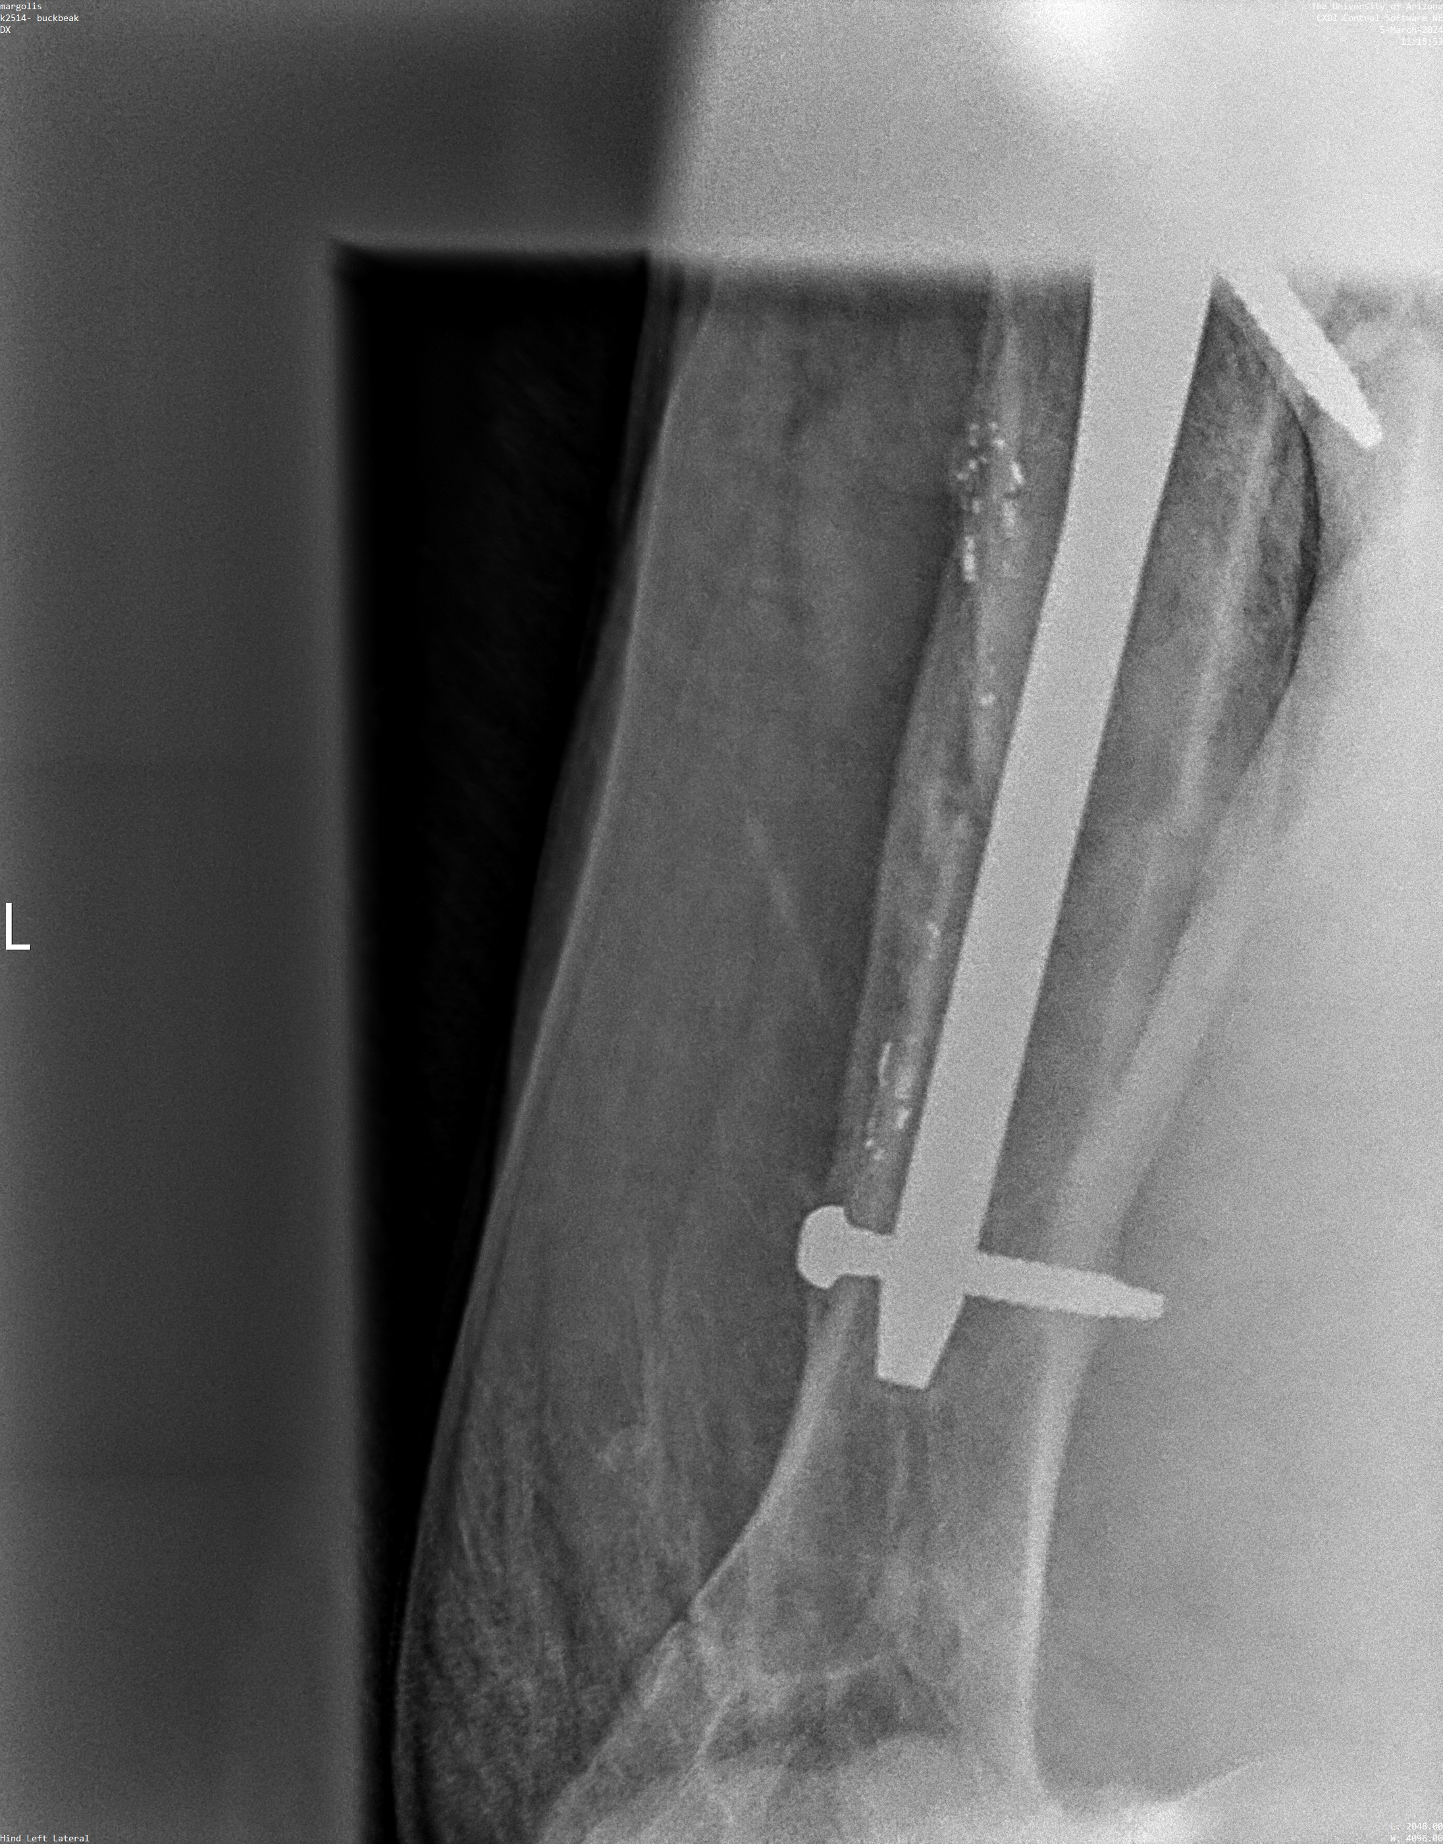
Results
*
*
*
*
*
*
*
Week 5
Week 6
Week 7
Week 8
Week 10
Week 11
Week 12
Figure 8: X-ray images between Week 5 to Week 12

Slide 10
Interpretation
For the first five weeks, the strain decrease
After Week 10, the strain goes up
From our initial testing, the sensors are showing good data

Slide 11
Impact
Continuing to improve the use of these sensors will be critical for astronauts in space
Analyzing strain and stress with other data will clearly show bone health and density
Hopefully, one day these sensors will be in space

Slide 12
Acknowledgements
PI: Dr. David Margolis
Space Grant Manager: Michelle Coe
Lab Manager: David Gonzales
PhD Student: Gerardo Figueroa

Slide 13
Thank You

